Slide 1
Image Recognition to Detect Different Vehicle Types in Riga
Eden Elisha Thomas, Dmitrijs Gizdevans, Gonzalo Gamez

Slide 2
Objective
This project focuses on training a model for accurate vehicle identification and classification within Riga, Latvia. The model is trained to recognize and categorize the following vehicle types
V (Passenger Vehicles): This category includes standard cars used for personal transportation.
C (Cargo Vehicles): This encompasses all commercial vehicles, from smaller vans (C1) to large trucks with trailers (C4).
S (Buses): This category specifically targets public transport buses.

Slide 3
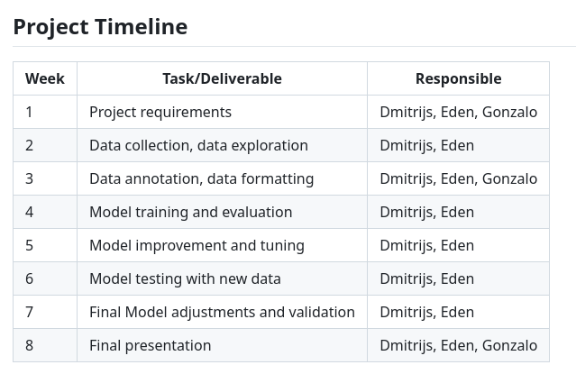
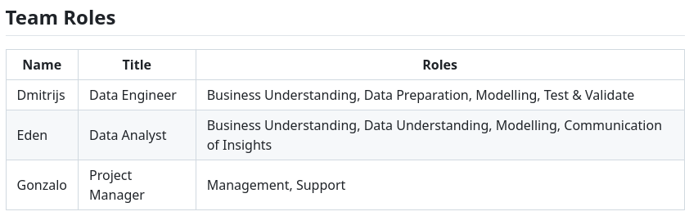
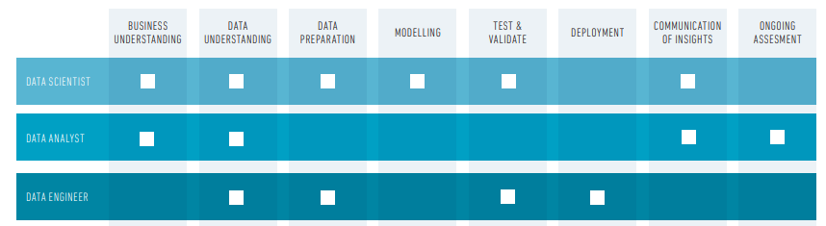
Team Coordination and Delegation
Table 2. Team Roles
Table 3. Data Science Competency Skills (Data To Decisions CRC, 2017)
Table 1. Project Timeline

Slide 4
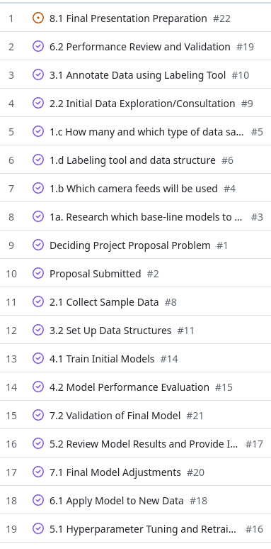
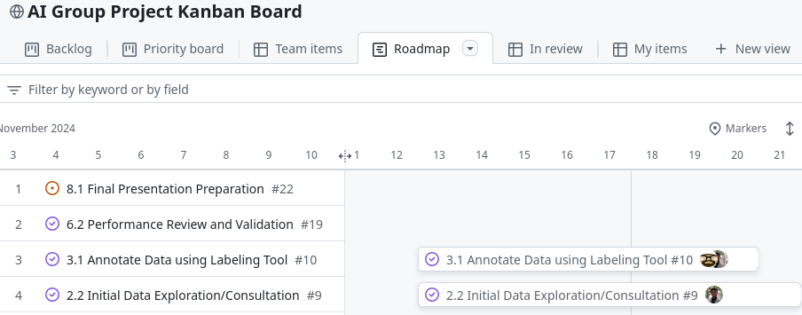
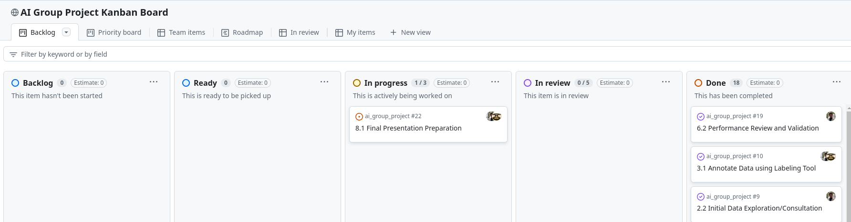
Team Coordination and Delegation
Fig 3. Kanban Board
Fig 2. Kanban Board Roadmap
Fig 1. Backlog

Slide 5

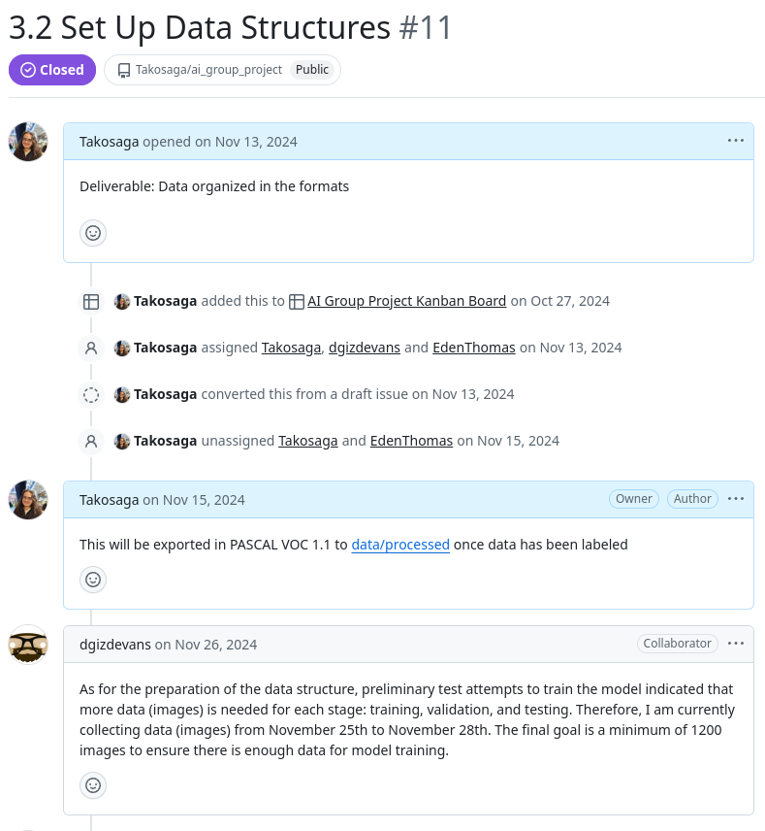


Team Coordination and Delegation
Fig 4. Google Meets logo
Fig 5. Google Docs with other logo
Fig 7. Whatsapp logo
Fig 6. Task write ups

Slide 6
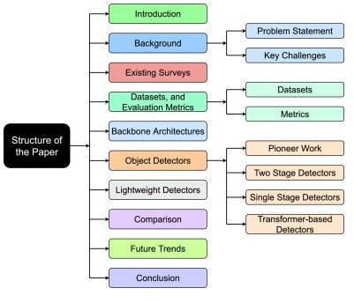
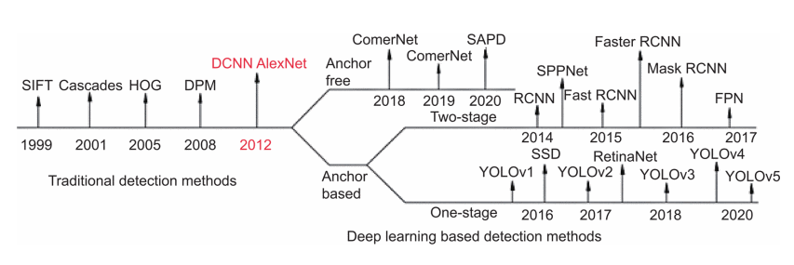
Research
Two-Stage Detectors: Region proposal + classification/refinement (e.g., Faster R-CNN). Higher accuracy, higher complexity.
One-Stage Detectors: Direct bounding box/class prediction (e.g., YOLO, SSD). Efficient, real-time capable.
Transformer-based Detectors: Emerging architecture (e.g., Swin Transformer). State-of-the-art accuracy.
Fig 9. Development of Vehicle Detection(Ma and Xue, 2024)
Fig 8. Survey of object detection by Zaidi et al. (2022)

Slide 7
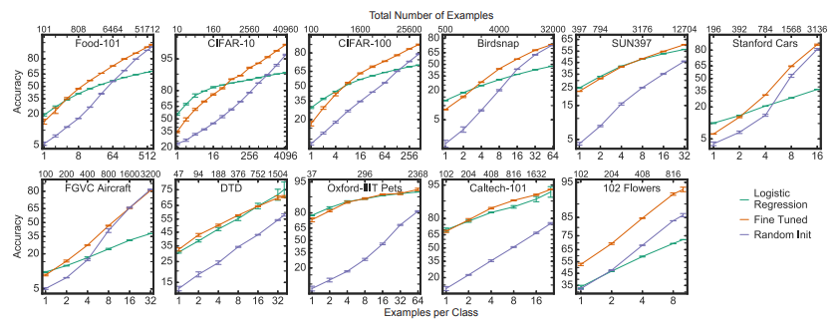
Research
Fig 10. Accuracy for total number of examples and examples per class (Kornblith, Shlens and Le, 2019)

Slide 8
Data Collection
Data Sources:
Public video streams from webcams capturing traffic scenes.
Extracted individual frames from streams to generate image datasets.
Challenges in Data Collection:
Providers often restricted access to video streams.
Required understanding of streaming technologies to bypass limitations.
Solution:
Customized HTTP headers to emulate approved devices, enabling continuous access to streams.
Extracted high-quality frames from public video streams using the FFmpeg library
Outcome:
Successfully gathered a large, diverse dataset of vehicle images from live webcam feeds.
Data collection process is detailed in the webcam_capture.ipynb notebook.
Data Storage:
Collected images securely stored in Google Cloud Storage (GCP buckets) for scalability and integration into the ML pipeline.

Slide 9
Data Collection
Annotation Process
Manual annotation was performed on the collected images using CVAT (Computer Vision Annotation Tool) to label the data accurately.
Labeled Classes
Passenger Vehicles (V)
Cargo Vehicles (C)
Buses (S)
Dataset Splitting : Data was manually divided into three sets:
Training Set (60%)
Validation Set (20%)
Testing Set (20%)
Challenges
Labeling was manually done and distributed among group members, which was time-intensive.
Ensuring consistency across annotations required thorough coordination and quality checks.

Slide 10
Model Training and Evaluation
Model Selection and Training
YOLOv8 was selected for its efficiency in object detection tasks.
Pre-trained weights were used as a starting point, and the model was fine-tuned with our labeled data.
Training Parameters
Epochs: 50
Image Size: 640x640
Batch Size: 16
Optimizer: AdamW
Evaluation Metrics
Precision, Recall, mAP@0.5, and mAP@0.5:0.95 were used to measure performance on validation and test datasets.
Challenges
Ensuring the model generalized well to unseen data.
Debugging and resolving configuration issues during training.
Infrastructure
Google Cloud Platform was utilized for saving and sharing training artifacts and results.

Slide 11
Data Augmentation and Enhanced Training
Objective:
Enhance model performance by introducing variability and diversity into the training dataset.
Key Techniques:
Applied transformations such as rotations, flips, brightness adjustments, and scaling using the Albumentations library.
Integrated augmentation pipeline directly into the training data preparation workflow.
Process Overview:
Original training dataset duplicated for augmentation to preserve baseline data integrity.
Augmented images used alongside original data for retraining the YOLOv8 model.
Challenges:
Managing increased storage and processing requirements for augmented datasets.
Ensuring augmented images maintained realism and meaningfulness for model training.
Results:
Augmented model demonstrated improved confidence and reduced variability in predictions across test sets.
Metrics showed an approximate 2.2% improvement in average confidence and a 5.5% reduction in standard deviation.

Slide 12
Testing on Unlabeled Data
Objective:
Evaluate the trained YOLOv8 model on unlabeled datasets to assess real-world performance.
Process Overview:
Five independent unlabeled test sets were created and processed using the trained model.
Predictions included bounding boxes and class labels (Passenger Vehicles, Cargo Vehicles, Buses).
Metrics calculated:
Average Confidence
Median Confidence
Standard Deviation
Class Distributions
Challenges:
Handling large-scale datasets and ensuring predictions aligned with real-world expectations.
Ensuring consistent processing for fair comparisons between baseline and augmented models.
Results:
Detailed metrics collected for each test set.
Augmented model showed improved confidence and reduced variability compared to the baseline model.

Slide 13
Challenges and Lessons Learned
Key Challenges:
Data Collection:
Limited access to video streams required bypassing restrictions using tools like ffmpeg and HTTP header modifications.
Data Annotation:
Manual labeling of a large dataset was time-intensive and required team coordination.
Annotation tasks were divided among team members but still consumed significant resources.
Model Training:
Training the YOLOv8 model with augmented data required additional computation and storage resources.
Debugging issues like failed predictions and model inconsistencies.
Lessons Learned:
Automation is critical for scaling tasks like annotation and augmentation to save time and resources.
Effective use of cloud platforms like Google Cloud significantly accelerates workflows.
Iterative testing and validation improve model reliability and performance.
The importance of documenting processes for reproducibility and collaboration.
Modern technologies and libraries allow for rapid development of AI solutions based on ready-made frameworks.
Preliminary planning and understanding of general principles greatly accelerate project workflows.

Slide 14
Evaluation of Models
Evaluation of Base Model on Test Dataset
Evaluation of Augmented Model on Test Dataset
Comparison
Evaluation of Base Model on Unlabeled Dataset
Evaluation of Augmented Model on Unlabeled Dataset
Comparison

Slide 15
Evaluation on Test Dataset
Key Metrics: Precision, Recall, mAP@0.5, mAP@0.5:0.95, IoU, conf
Test dataset contained labeled images for three classes: Passenger Vehicles (V), Cargo Vehicles (C), and Buses (S).
Model evaluation conducted using the .val() function of YOLOv5.
Evaluated the model across varying IoU thresholds (0.3 to 0.9).
Confidence thresholds varied to assess precision and recall tradeoffs.
Outputs included:
Class-wise metrics saved in CSV files (metrics_v.csv, metrics_s.csv, metrics_c.csv).
Overall metrics (metrics_all.csv).
Visualizations: Confusion Matrix, Precision-Recall, F1-Confidence curves etc.

Slide 16
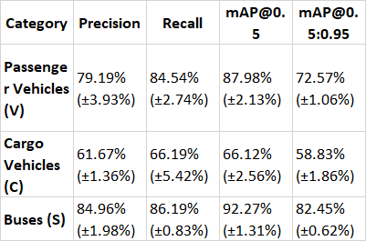
Evaluation of Base Model on Test Dataset
Overview Metrics
Precision: 75.27% (±2.21%)
Recall: 78.98% (±2.93%)
mAP@0.5: 82.12% (±1.91%)
mAP@0.5:0.95: 71.28% (±0.85%)
Class Specific Metrics on the right
Table 4. Evaluation of Base Model

Slide 17
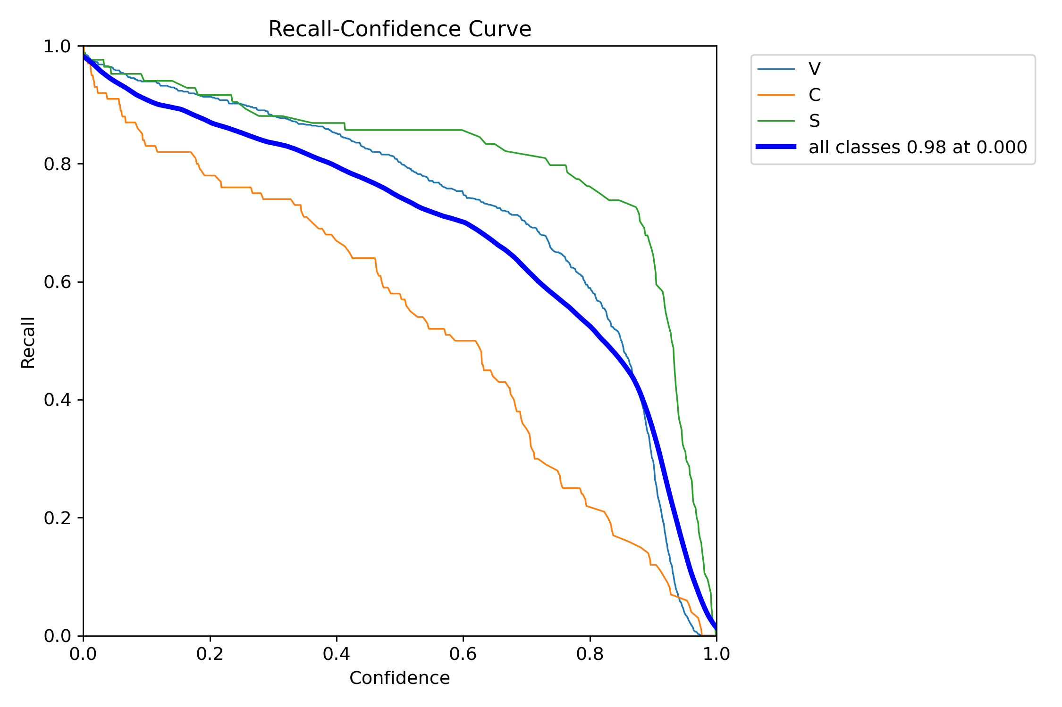
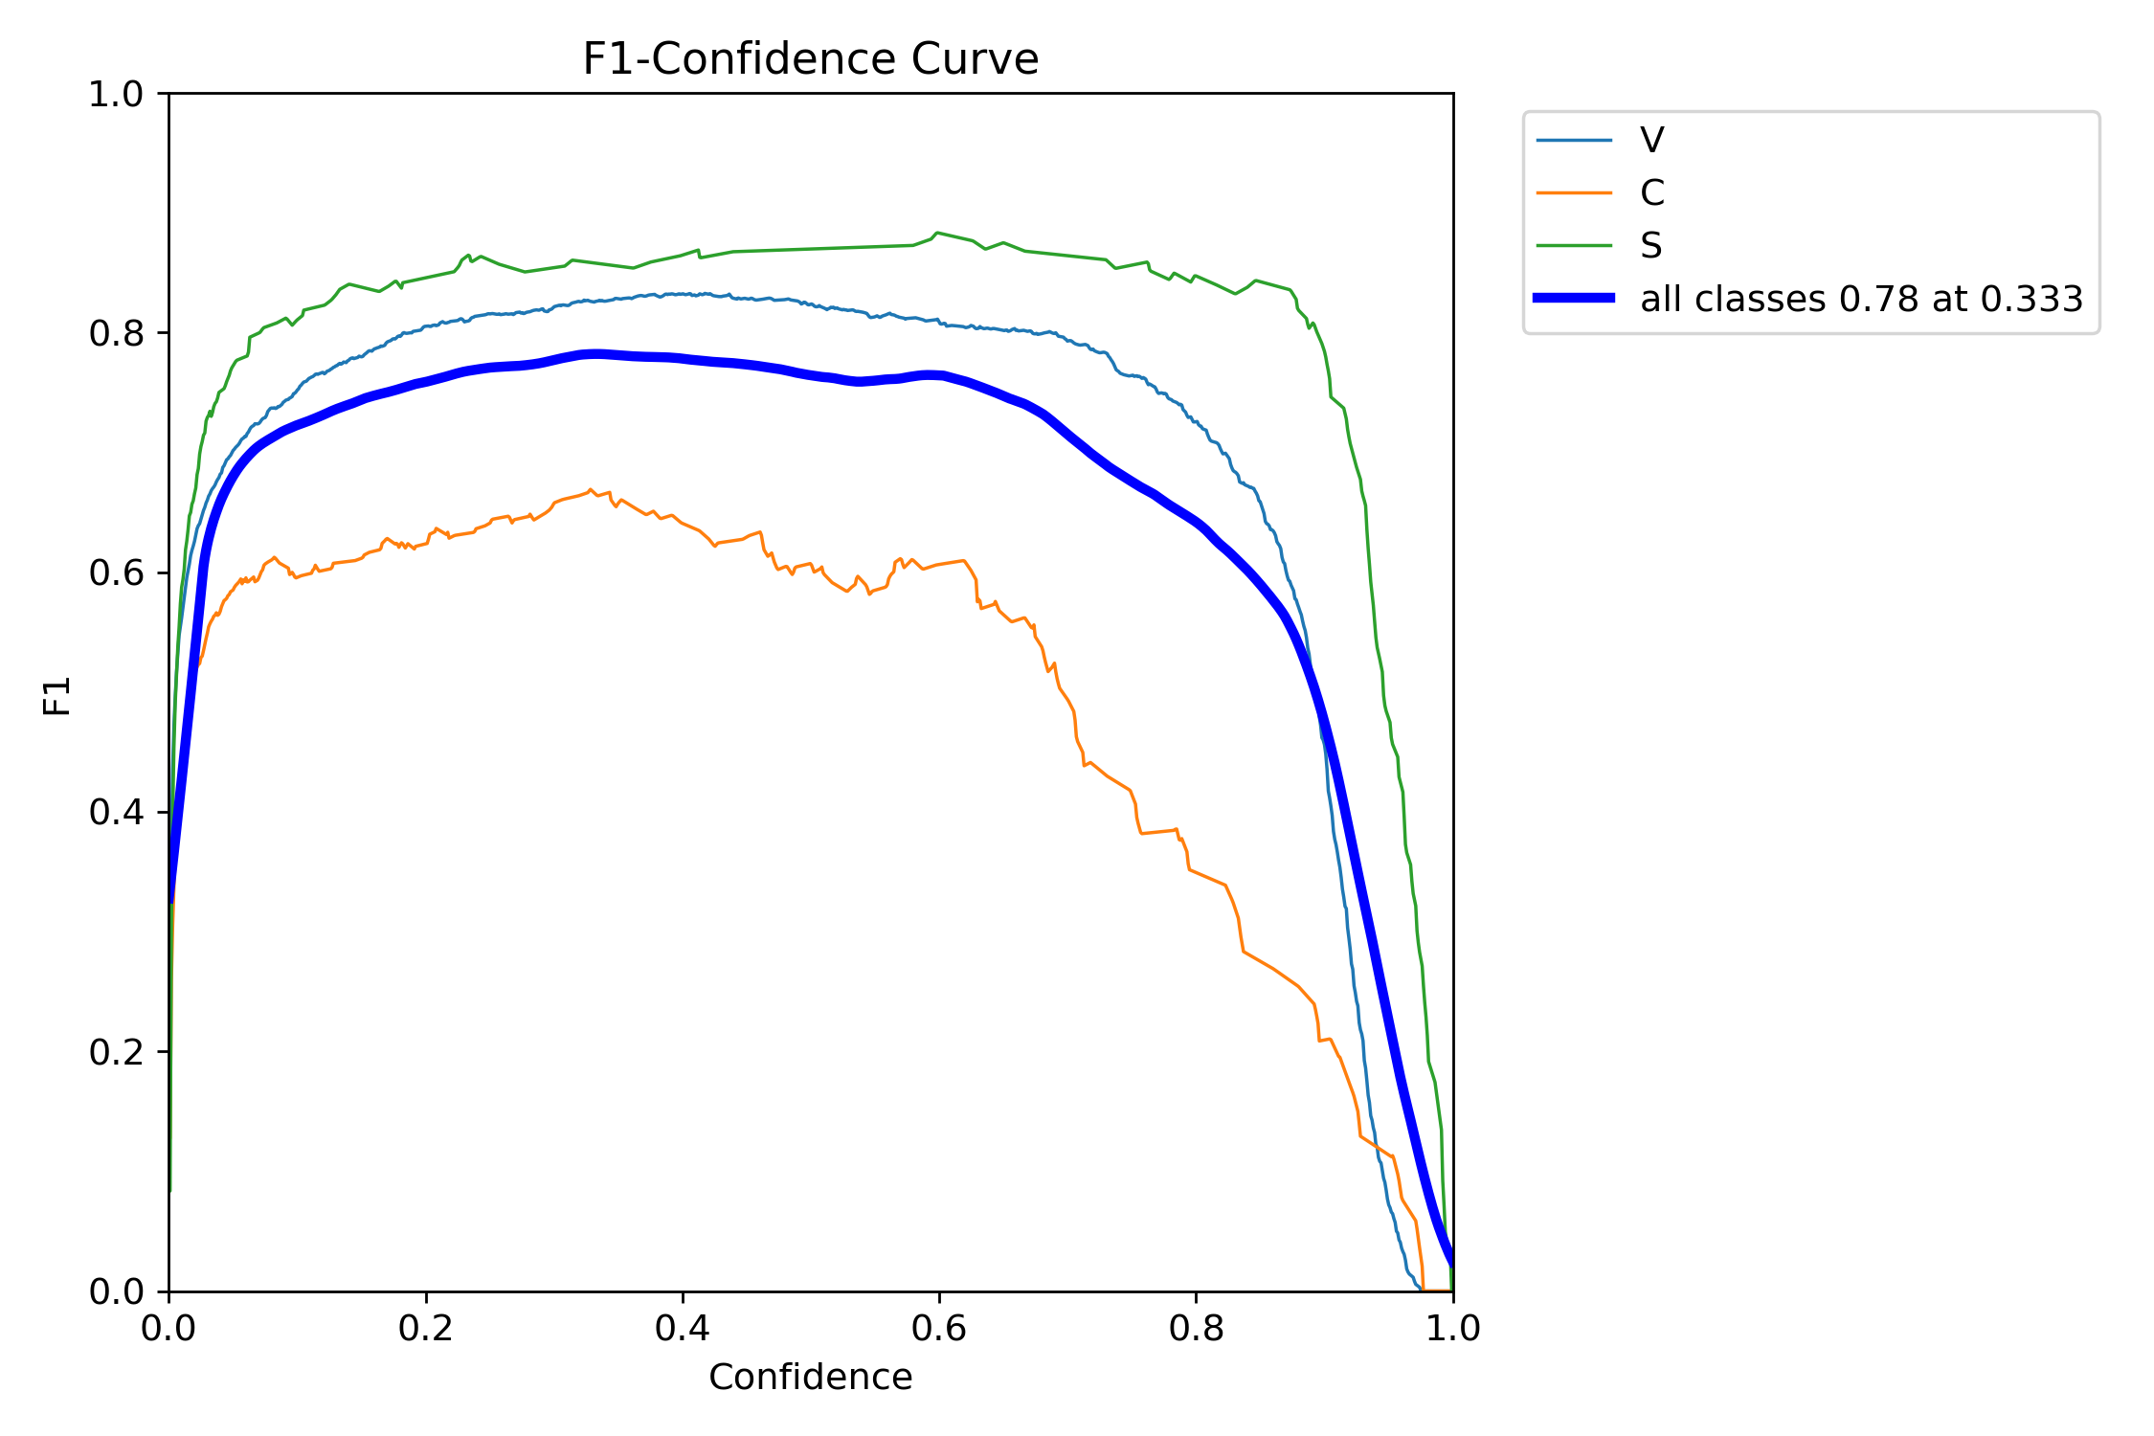
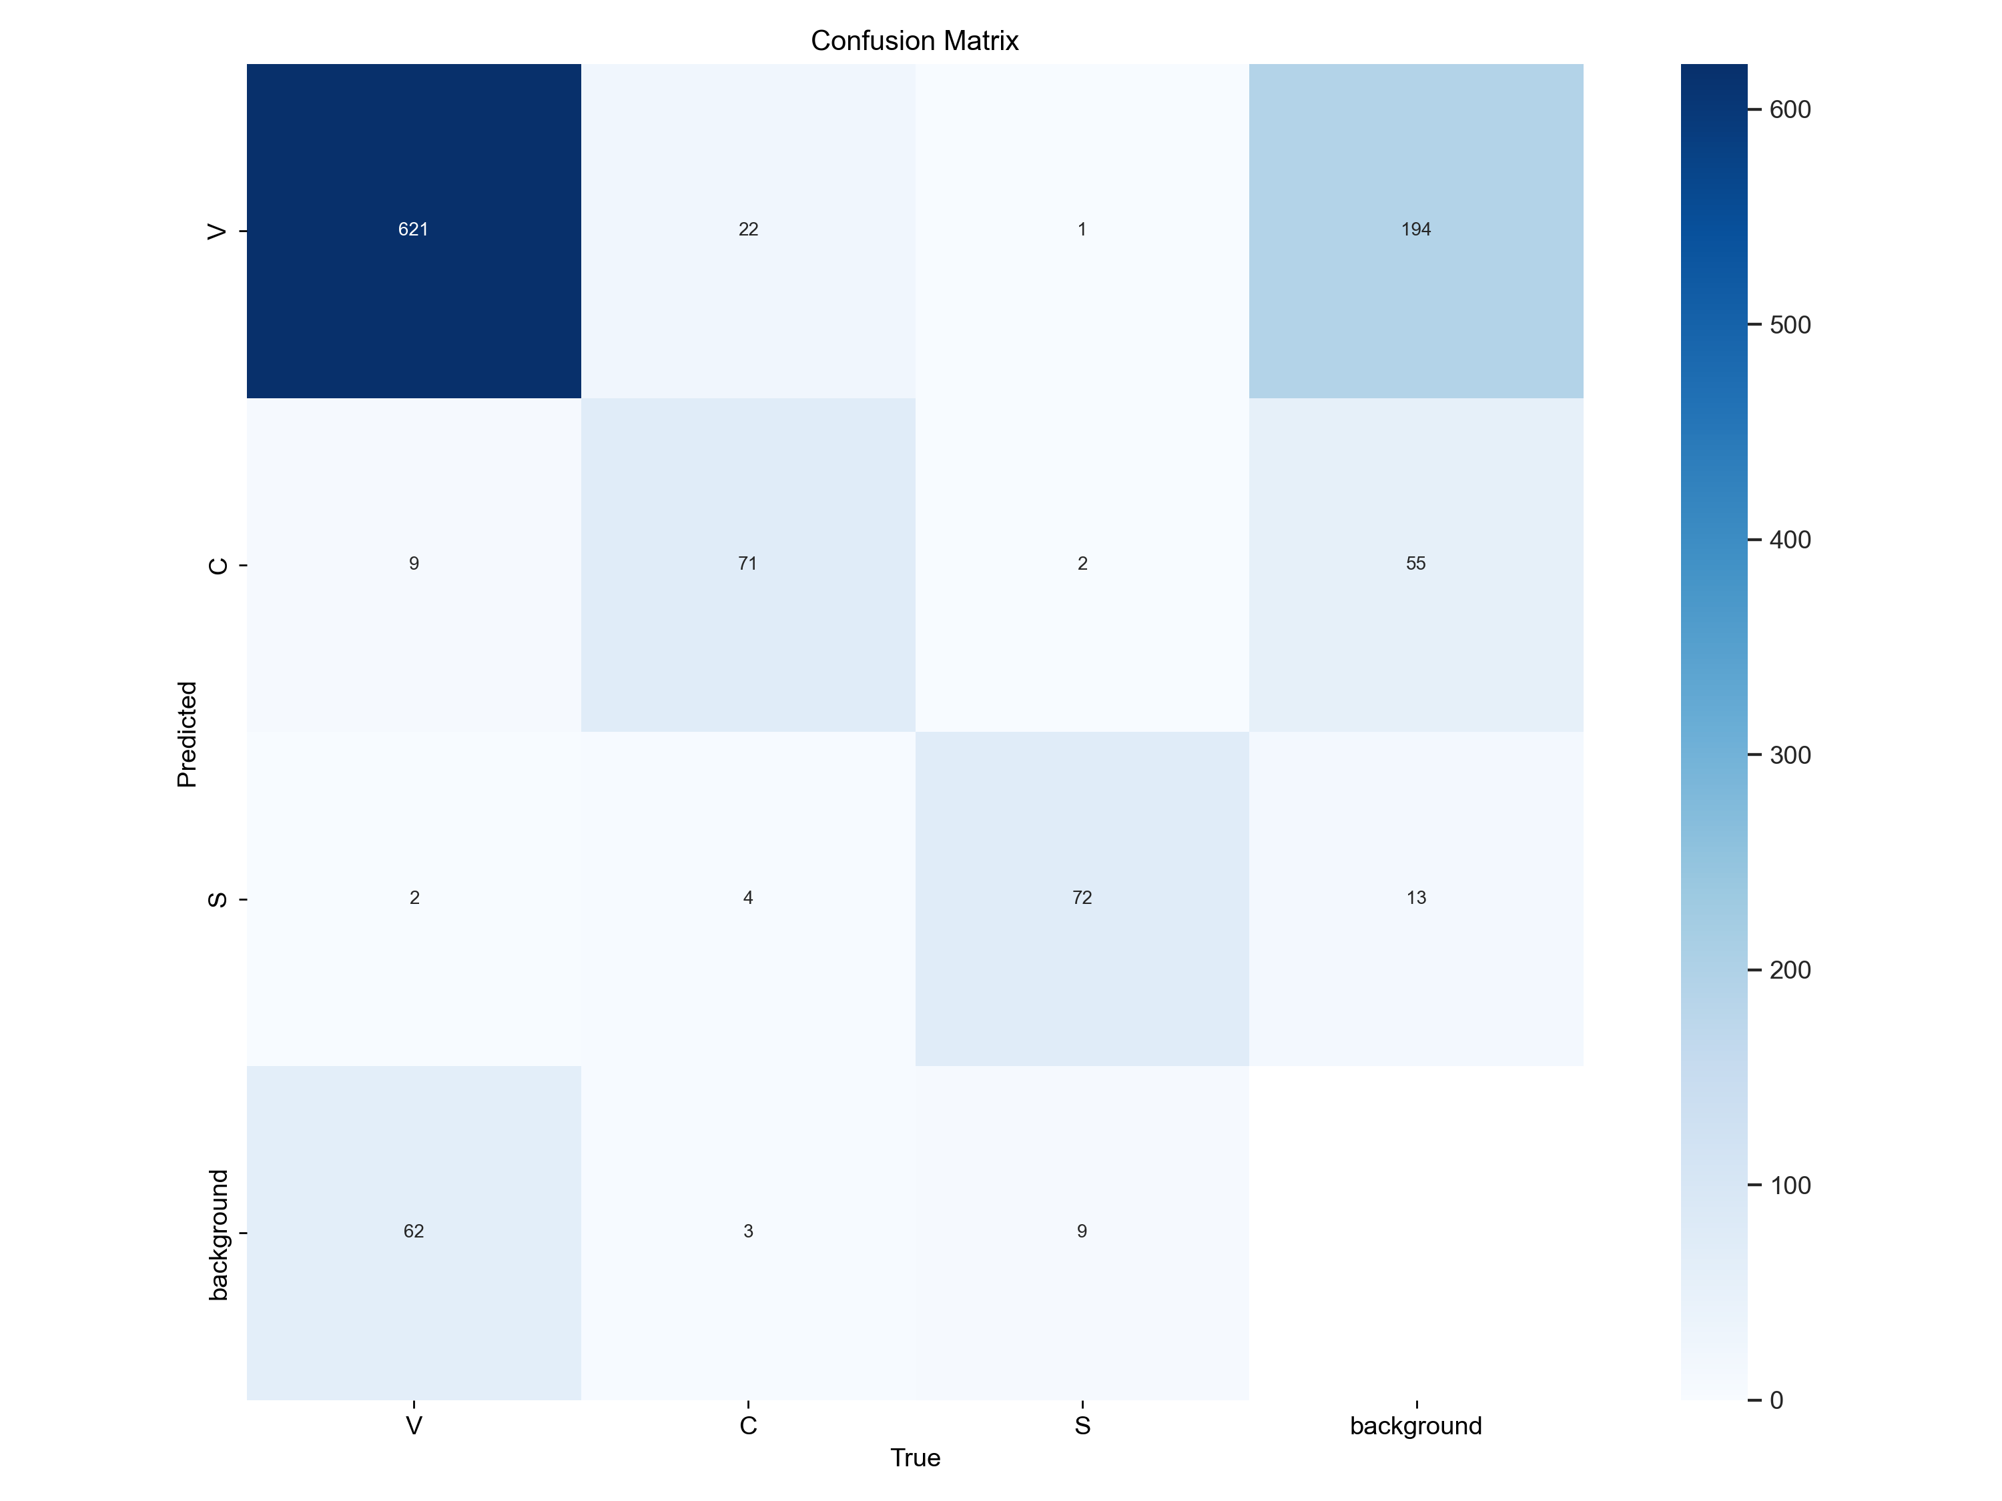
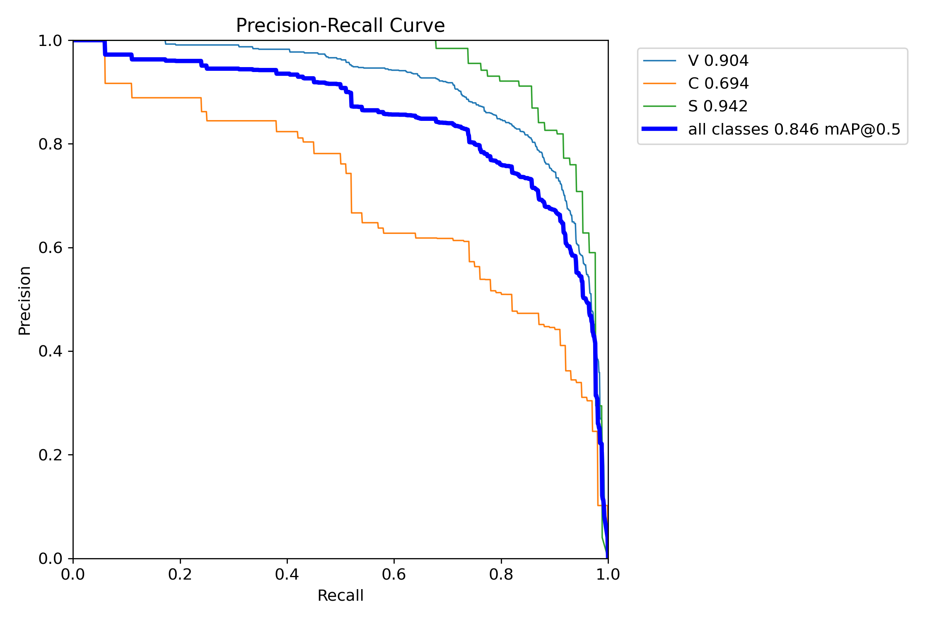
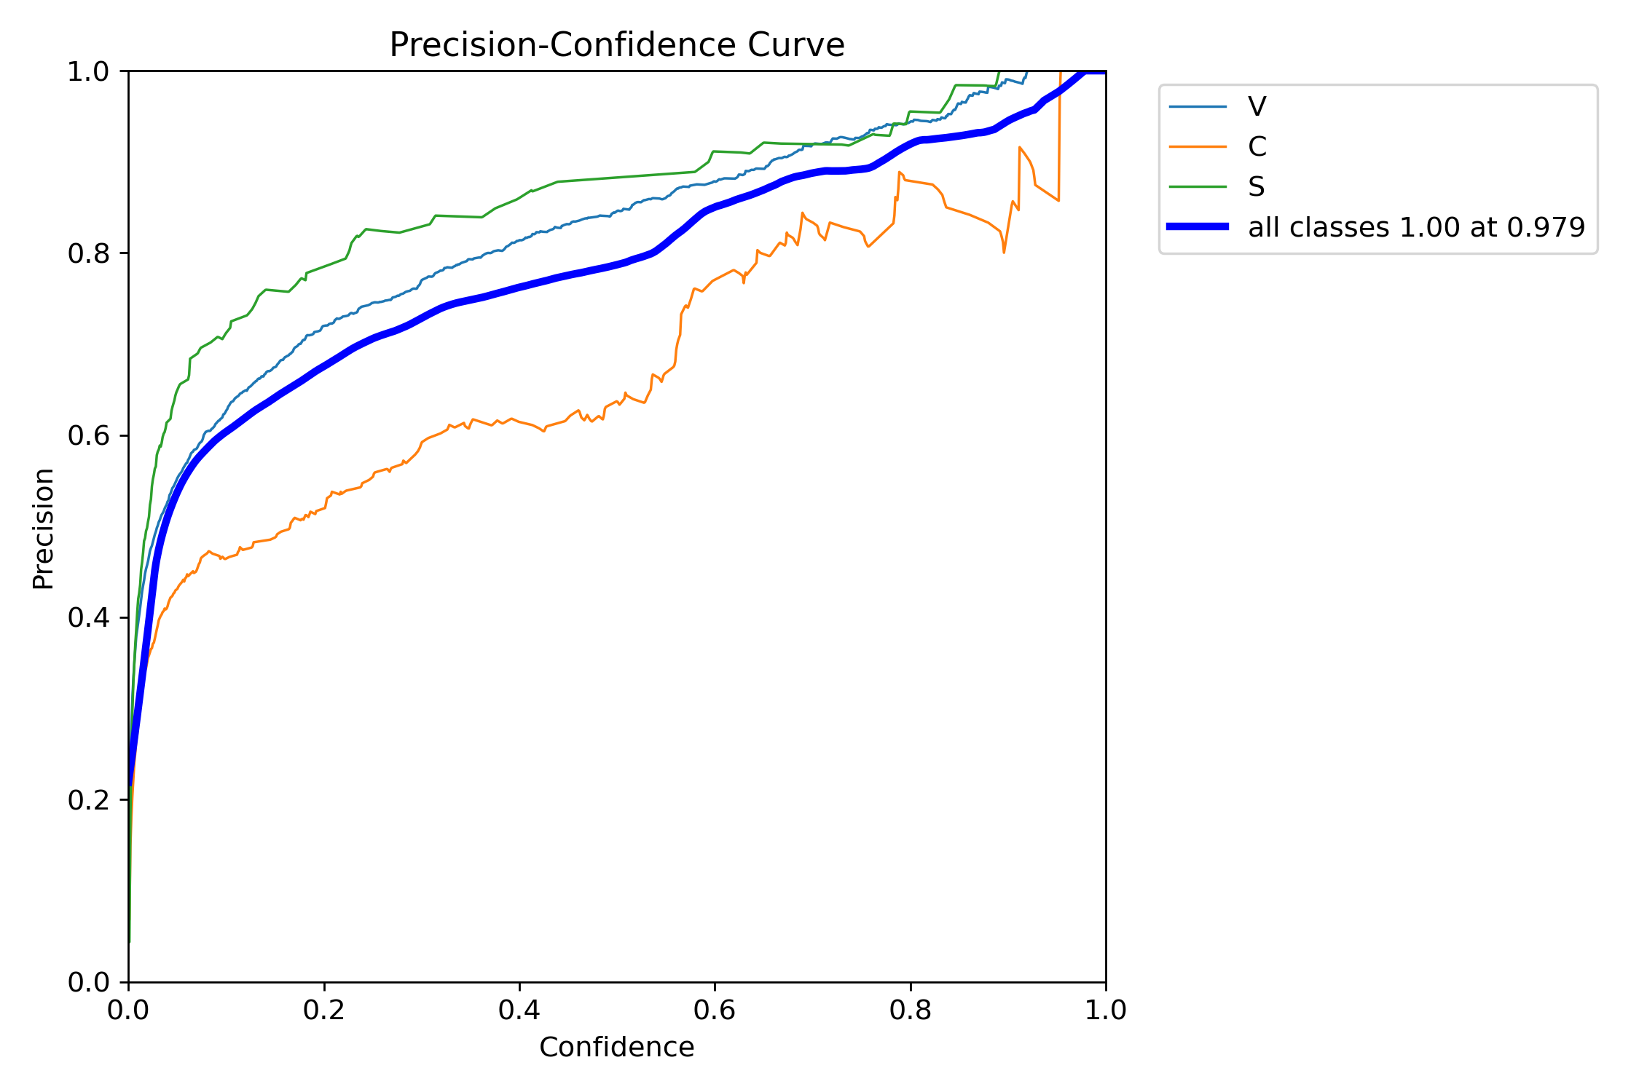
Fig 11. Recall-Confidence Curve Base Model
Fig 14. F1-Confidence Curve Base Model
Fig 13. Heatmap Base Model
Fig 12. Precision-Recall Curve Base Model
Fig 15. Precision-Confidence Curve Base Model

Slide 18
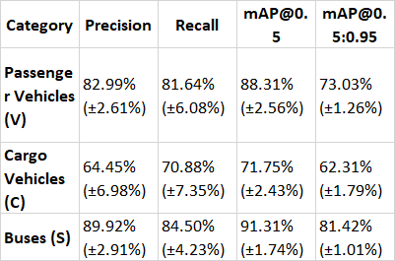
Evaluation of Augmented Model on Test Dataset
Overview Metrics
Precision: 79.12% (±3.91%)
Recall: 79.01% (±5.88%)
mAP@0.5: 83.79% (±2.21%)
mAP@0.5:0.95: 72.25% (±1.17%)
Class Specific Metrics on the right
Table 5. Evaluation of Augmented Model

Slide 19
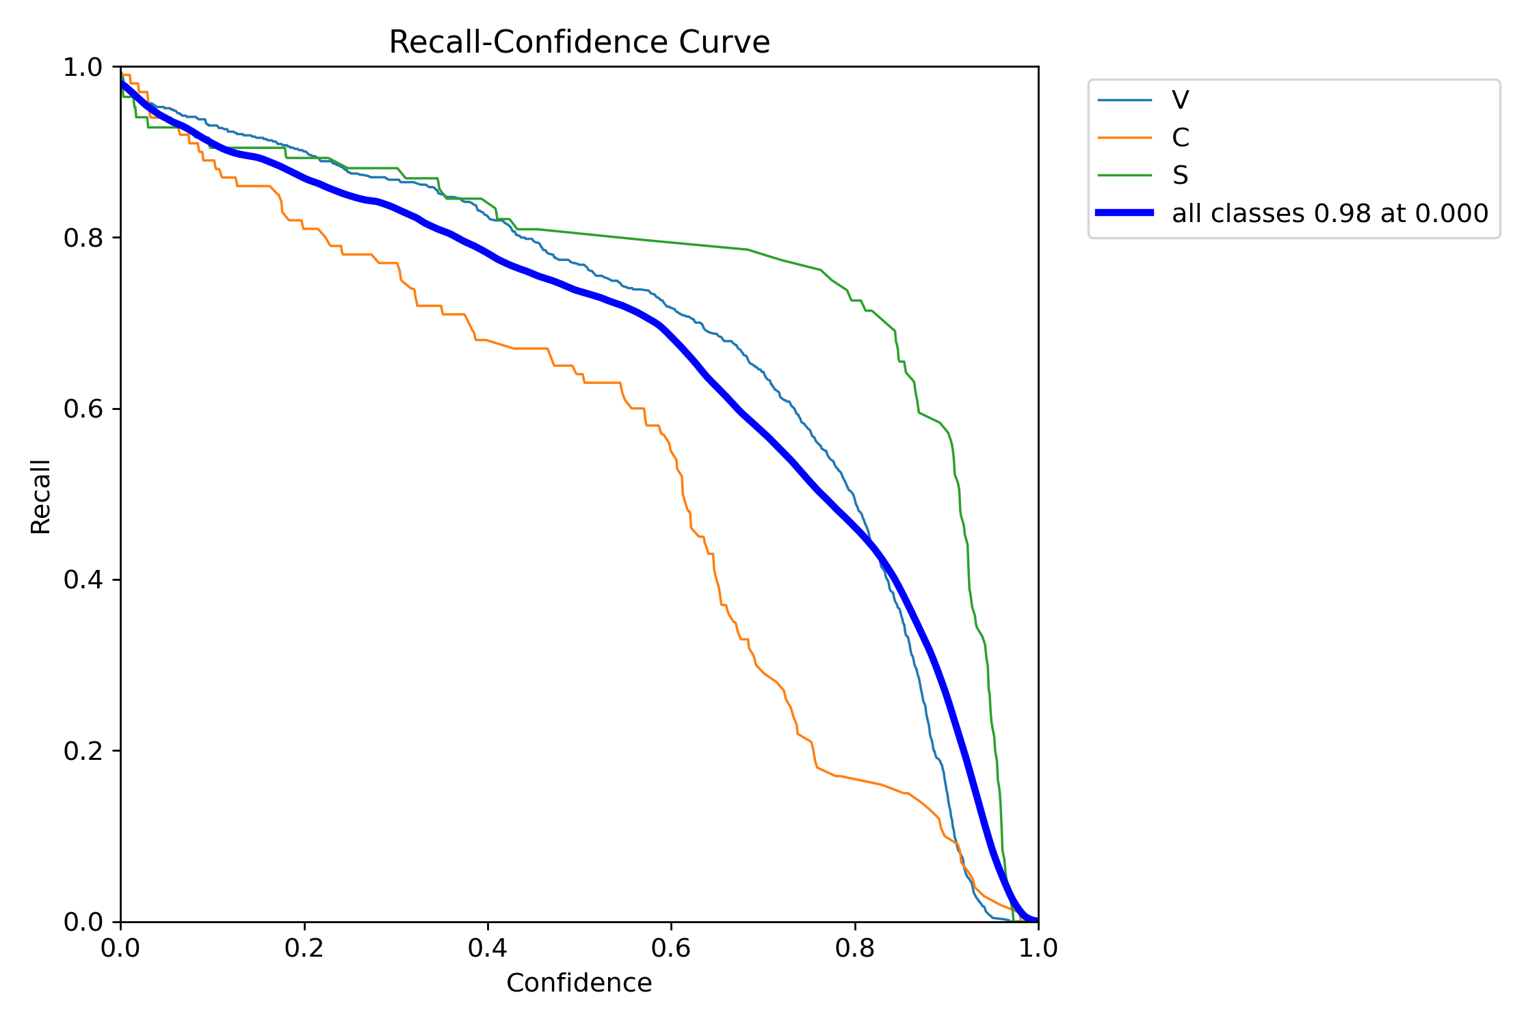
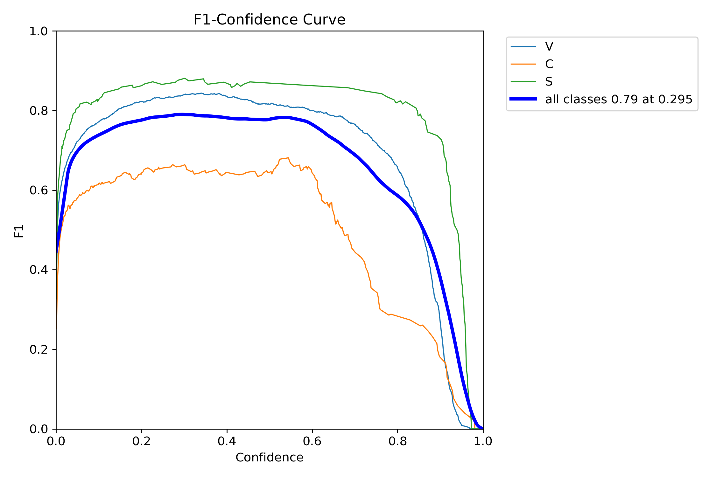
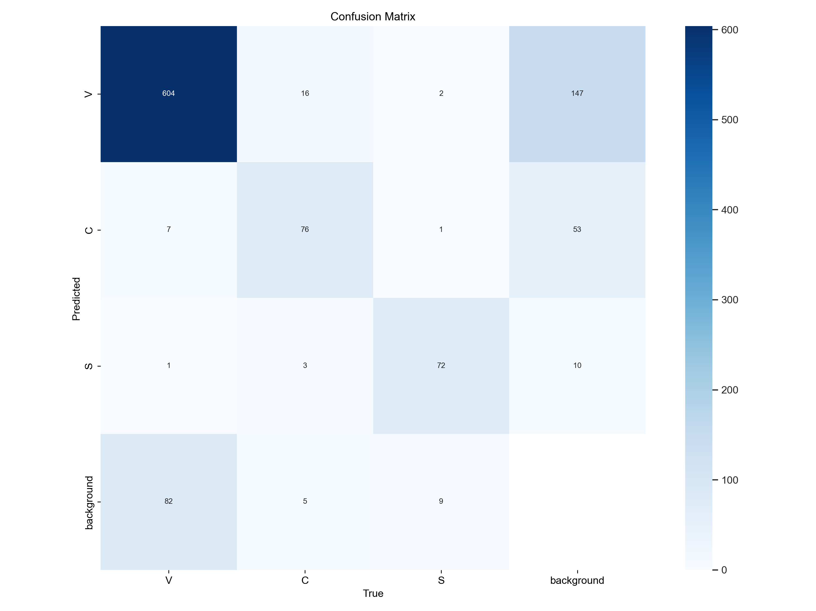
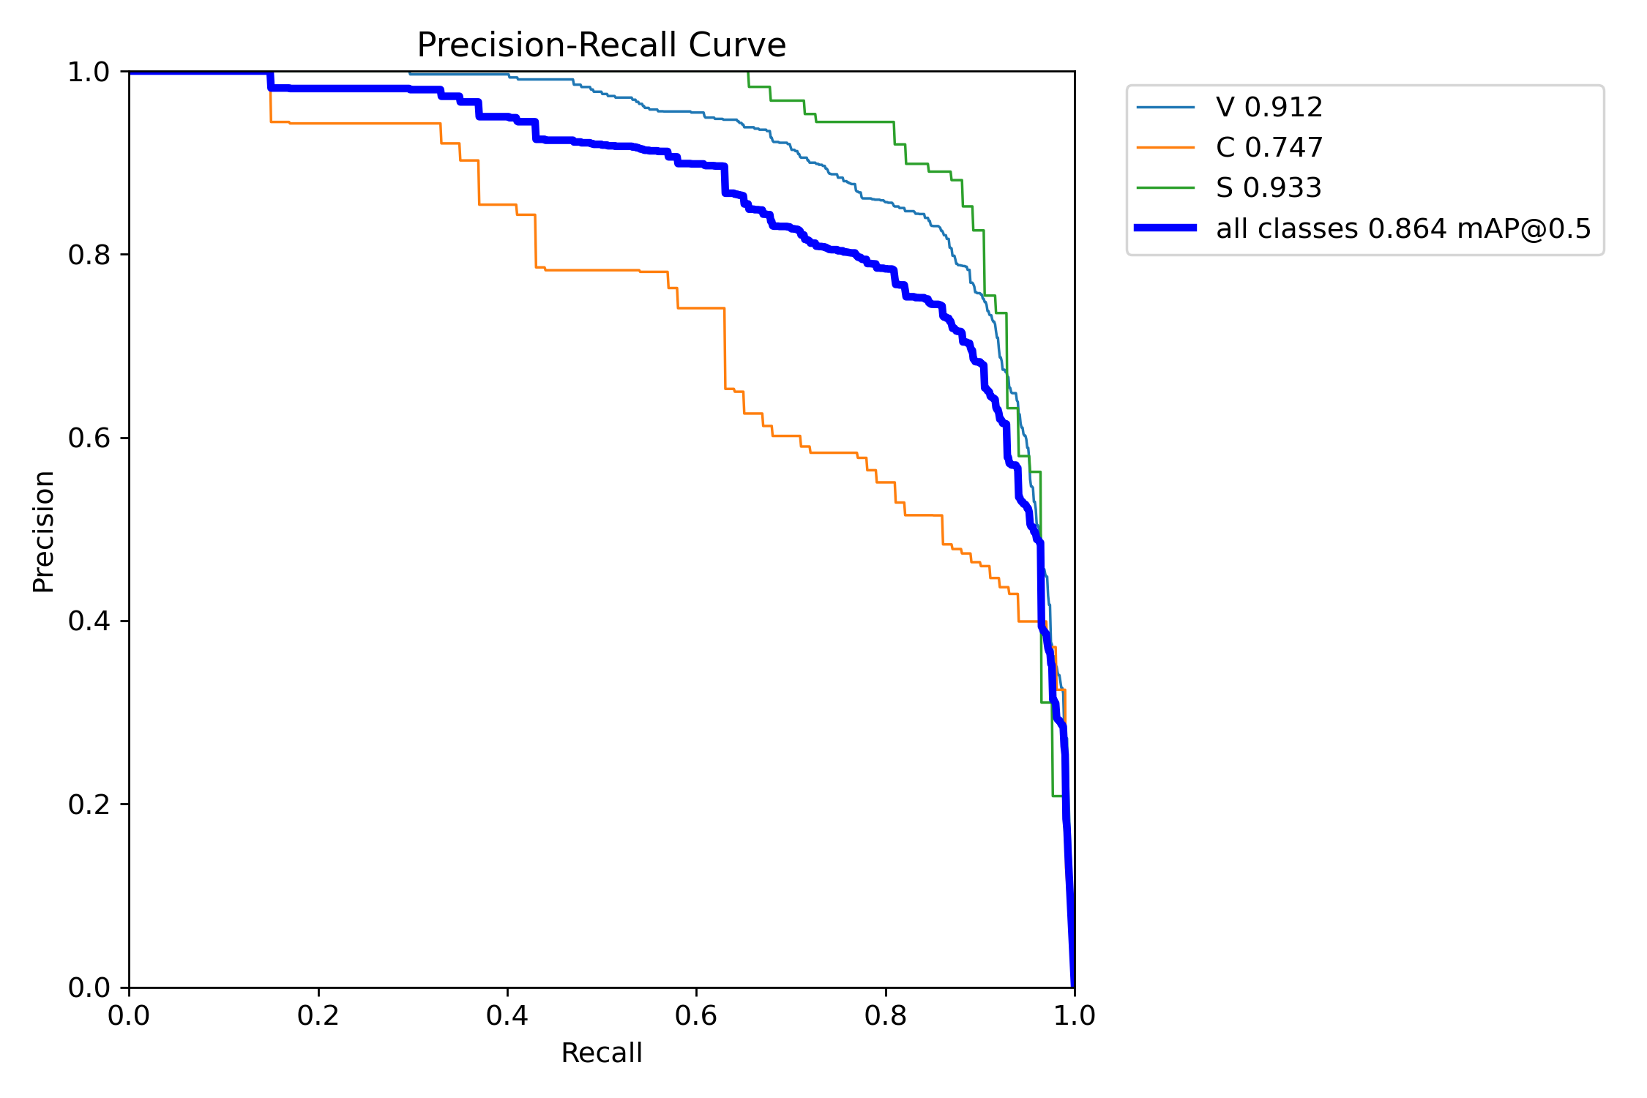
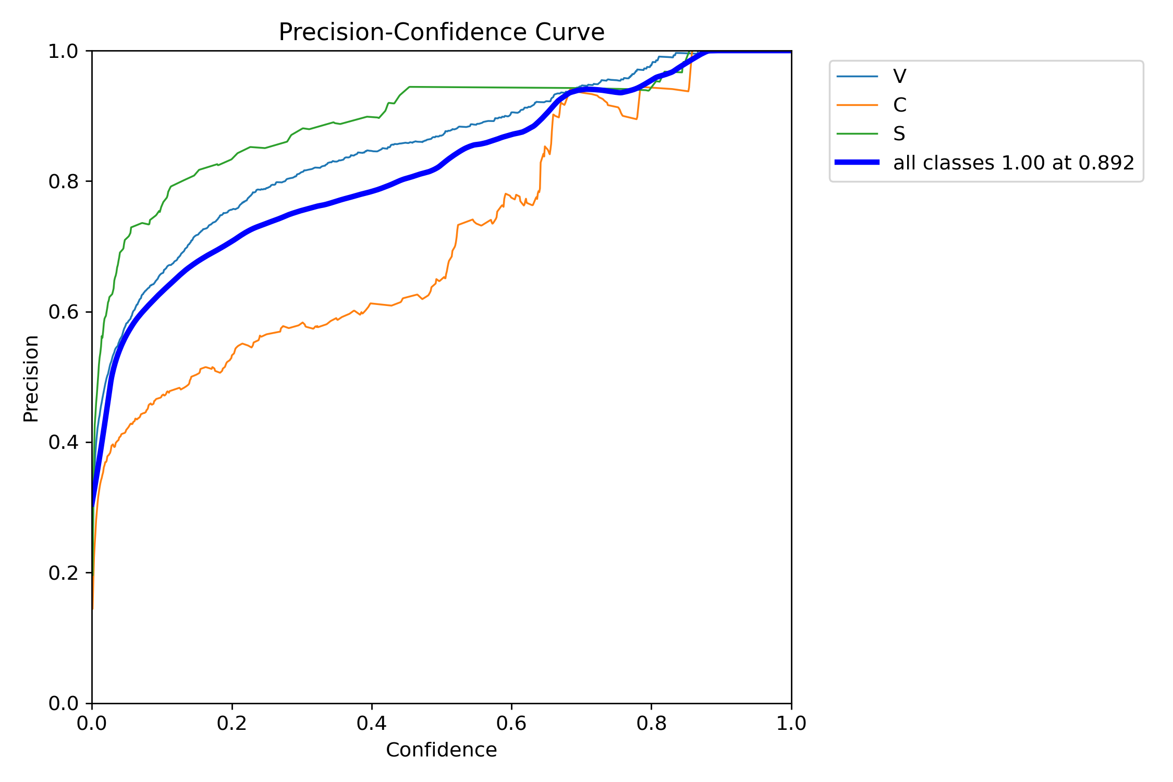
Fig 16. Recall-Confidence Curve Augmented Model
Fig 19. F1-Confidence Curve Augmented Model
Fig 18. Heatmap Augmented Model
Fig 17. Precision-Recall Curve Augmented Model
Fig 20. Precision-Confidence Curve Augmented Model

Slide 20
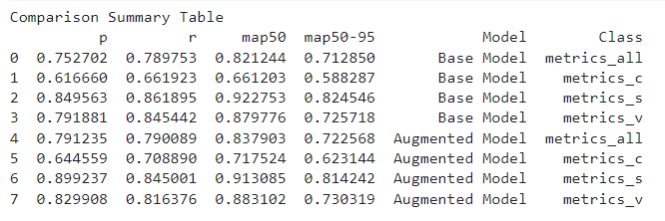
Comparison of Models
Python scripts aggregated metrics for precision, recall, and mAP values.
Comparison plots generated using matplotlib and pandas.
Table 6. Comparision Summary Table

Slide 21
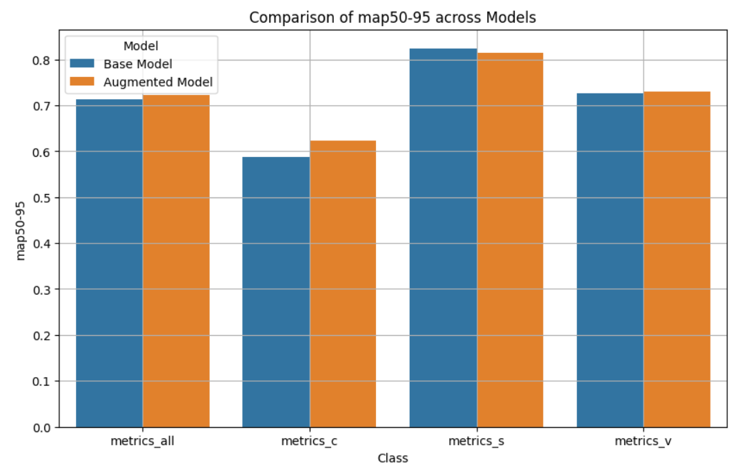
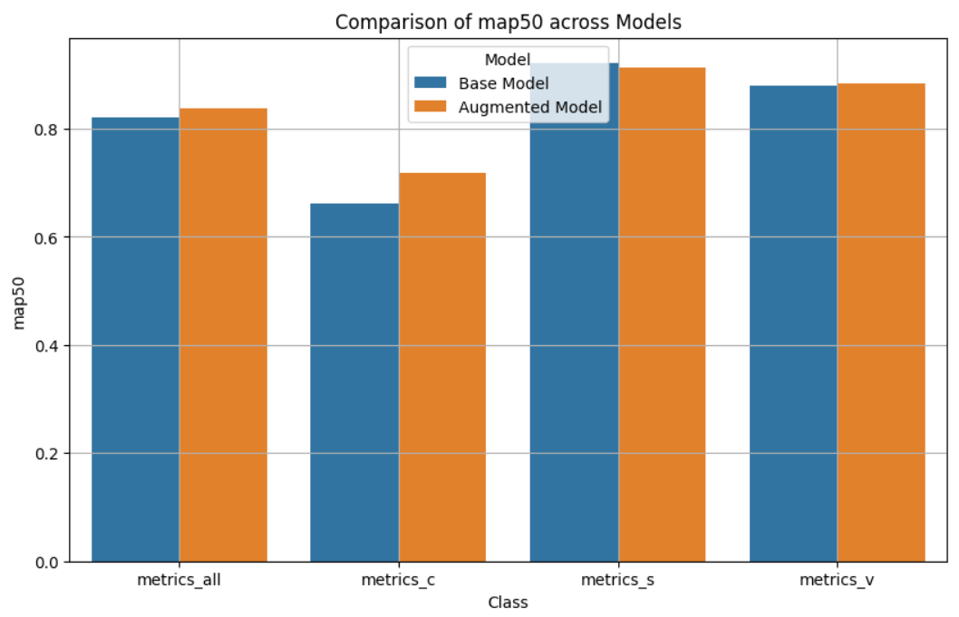
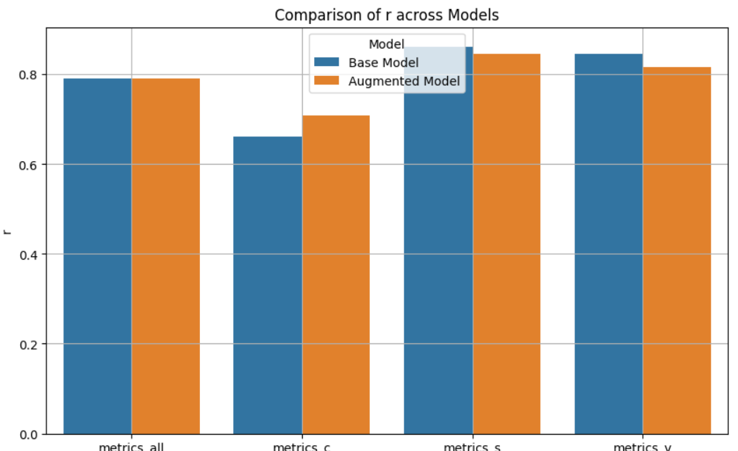
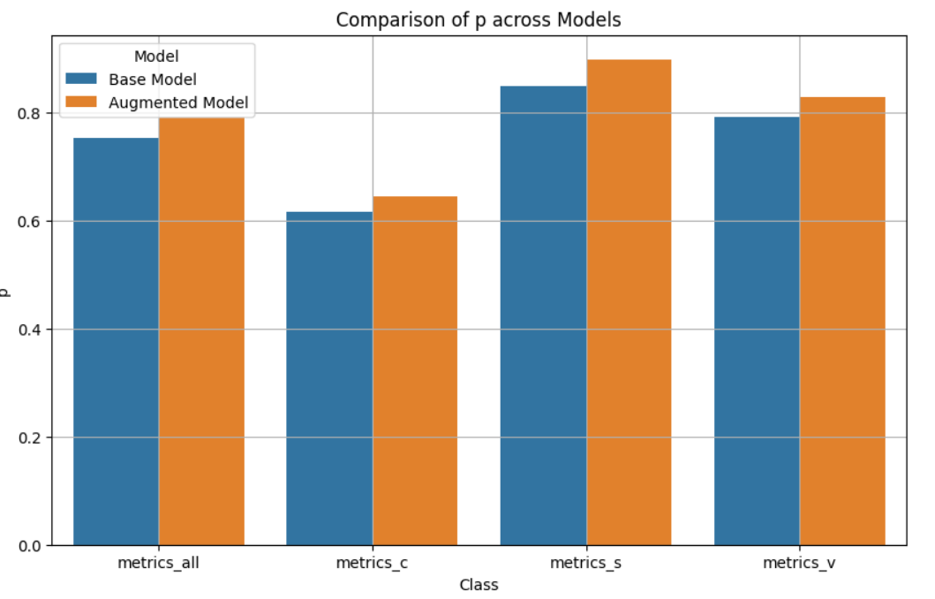
Fig 21. Comparison of map50-95
Fig 23. Comparison of map50
Fig 22. Comparison of r
Fig 24. Comparison of p

Slide 22
Evaluation of Base and Augmented Model on Unlabeled Data
Key Evaluation Areas:
Class Distributions
Confidence Scores (average, spread, and variability)
Agreement Ratios
Bounding Box Dimensions (width and height)
Models used .predict() function to analyze the test sets.
Metrics derived include:
Agreement ratios for model predictions.
Average confidence scores and their variability.
Class distribution percentages.
Average bounding box dimensions.

Slide 23
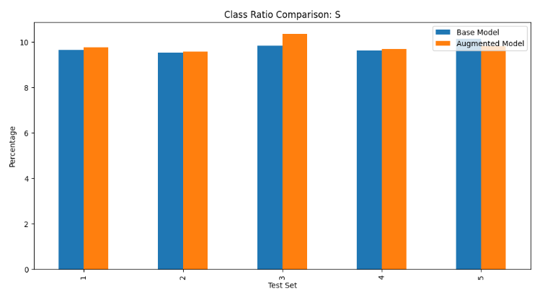
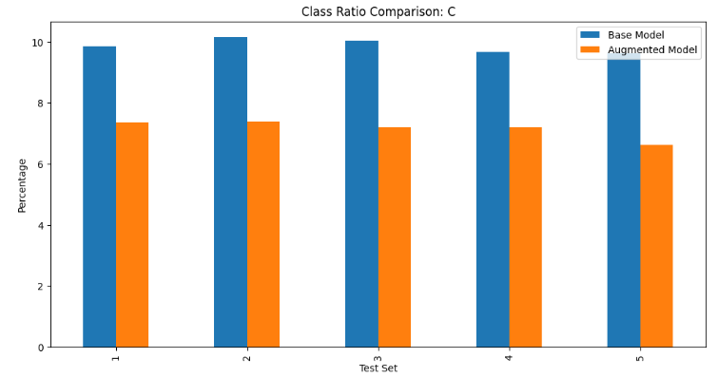
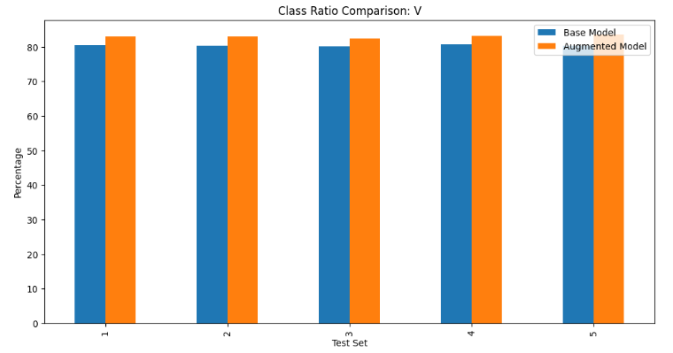
Class Distribution Comparison
Fig 25. Class Ratio Comparision: S
Base Model:
Passenger Vehicles (V): 80.30%
Cargo Vehicles (C): 10.11%
Buses (S): 9.59%
Augmented Model:
Passenger Vehicles (V): 83.01% (increase)
Cargo Vehicles (C): 7.16% (decrease)
Buses (S): 9.83% (slight increase)
Fig 26. Class Ratio Comparision: C
Fig 27. Class Ratio Comparision: V

Slide 24
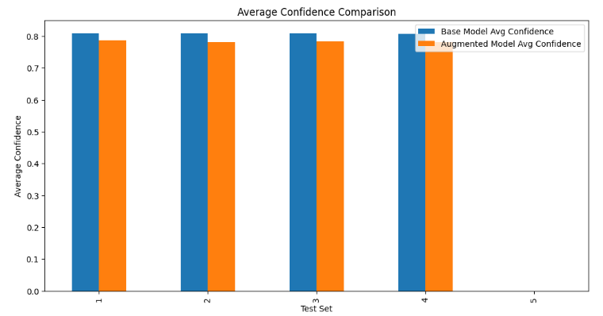
Confidence Score Comparison
Overall Confidence Scores:
Base Model: 0.8099
Augmented Model: 0.7833 (slightly lower overall confidence)
Confidence Variability Across Test Sets:
Test Set 5: Base = 0.8079, Augmented = 0.7814 .
Test Set 4: Base = 0.8109, Augmented = 0.7838 .
Test Set 3: Base = 0.8106, Augmented = 0.7822 .
Test Set 2: Base = 0.8115, Augmented = 0.7863 .
Test Set 1: Base = 0.8084, Augmented = 0.7827 .
Fig 28. Average Confidence Comparision

Slide 25
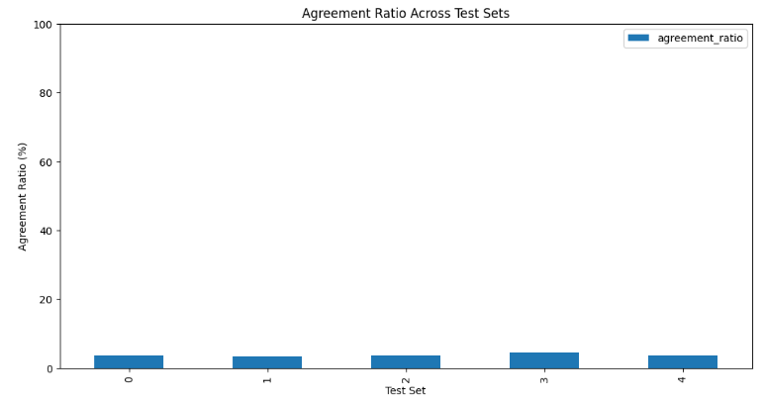
Agreement Ratio Comparison
Agreement ratios measure prediction consistency between models.
Findings:
Agreement ratio ranges from 3.45% to 4.43% across test sets.
Indicates divergent behavior in predictions for some samples.
Fig 29. Agreement Ratio

Slide 26
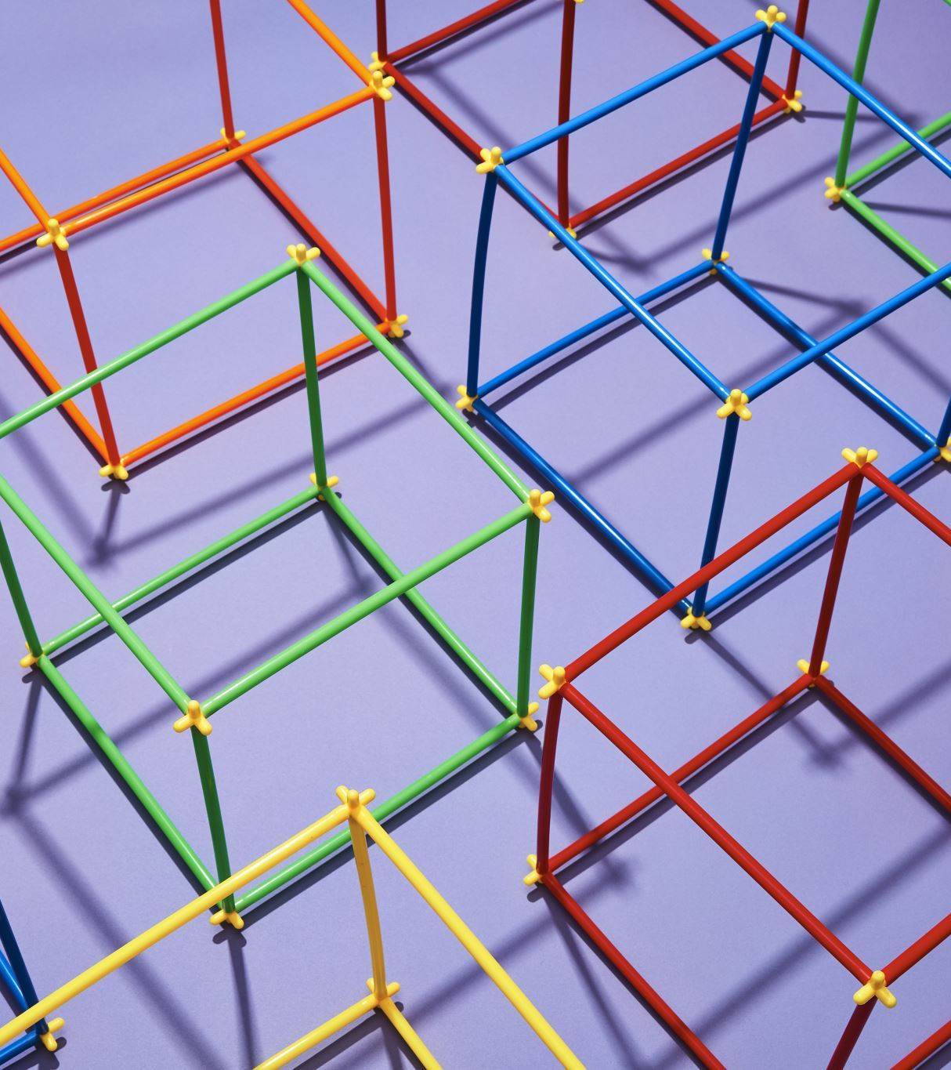
Average Bounding Box Comparison
Base Model:
Average width: ~120 pixels
Average height: ~60 pixels
Augmented Model:
Average width: Slightly reduced compared to the base model.
Average height: Consistently smaller than base model.

Slide 27
Unlabeled Data Evaluation Summary
Class Distributions:
Augmented model predicts fewer Cargo Vehicles but more Passenger Vehicles.
Similar performance on Buses across models.
Confidence Scores:
Base model maintains higher confidence overall.
Augmented model shows consistent confidence spread across test sets.
Agreement Ratios:
Low agreement ratios indicate significant differences in predictions.
Bounding Box Dimensions:
Augmented model predicts smaller boxes, potentially improving specificity.

Slide 28

Conclusions and Recommendations

Slide 29
Questions?

Slide 30
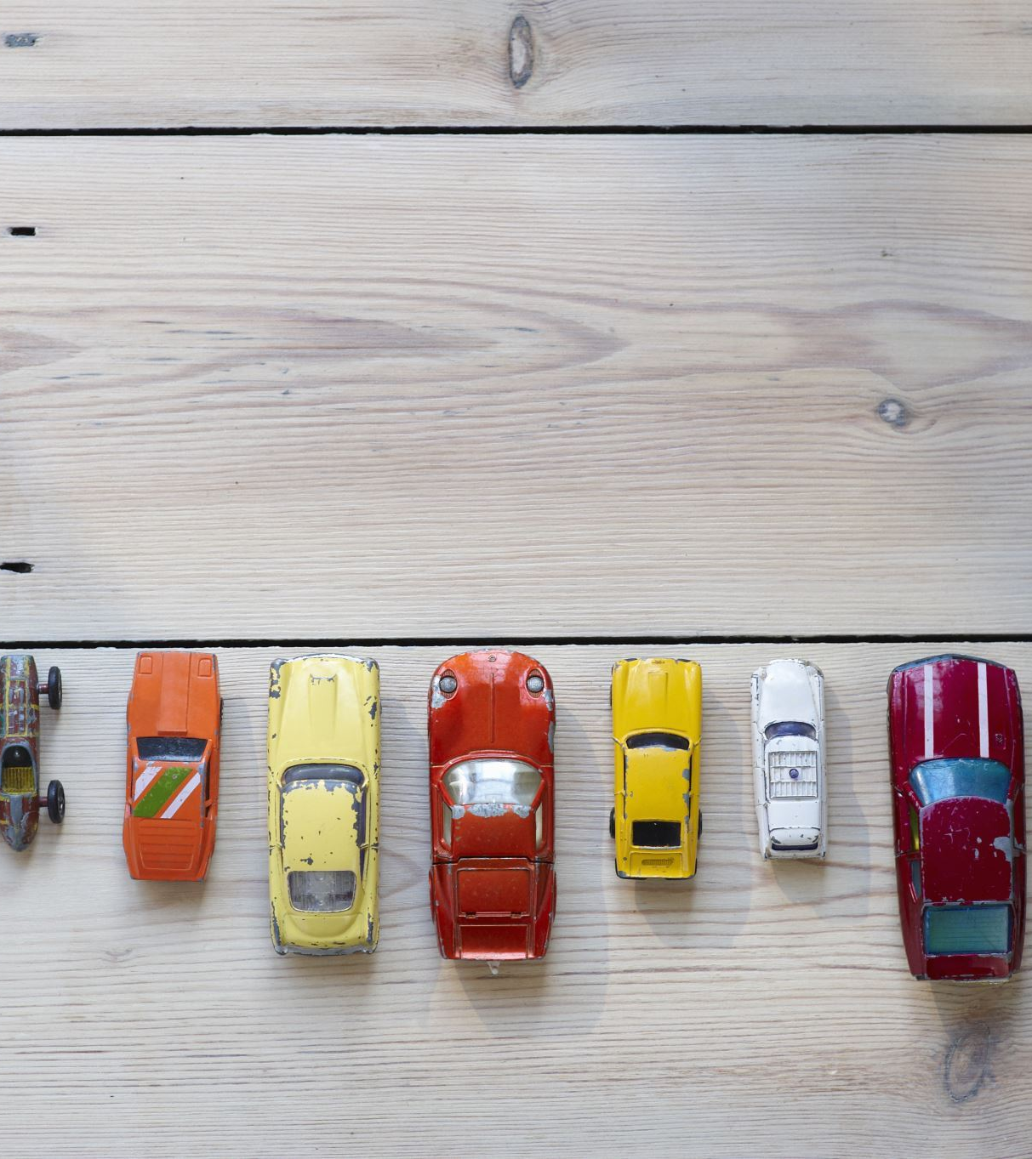
Reference list
Kornblith, S., Shlens, J. and Le, Q.V. (2019). Do Better ImageNet Models Transfer Better? arXiv:1805.08974 [cs, stat]. [online] Available at: https://arxiv.org/abs/1805.08974.
Ma, C. and Xue, F. (2024). A Review of Vehicle Detection Methods Based on Computer Vision. Journal of Intelligent and Connected Vehicles, 7(1), pp.1–18. doi:https://doi.org/10.26599/jicv.2023.9210019.
Zaidi, S.S.A., Ansari, M.S., Aslam, A., Kanwal, N., Asghar, M. and Lee, B. (2022). A survey of modern deep learning based object detection models. Digital Signal Processing, 126, p.103514. doi:https://doi.org/10.1016/j.dsp.2022.103514.

Slide 31
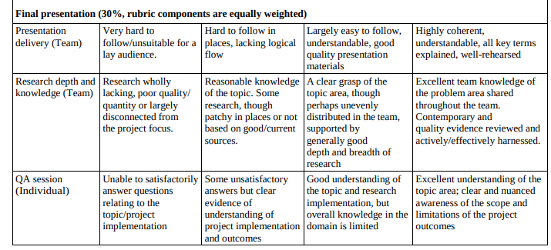
Presentation Rubric
Should cover the main areas documented in the project’s technical report, including:
- research conducted on the topic area.
- team coordination, delegation, and project management. (Gonzalo)
- technical implementation, including challenges encountered and how they were addressed.
- conclusions, recommendations and reflection

